Slide 1

Is ORM a Friend or an Enemy?
Pacemaker Java 2014
December 6, 2014 by Vitaliy Bashun

Slide 2
Agenda:
ORM motivation
Design strategies
Database design
ORM tips

Slide 3
Why ORM?
Integrate with data layer faster and easier
Concentrate on the logic NOT on the data
Make database operations transparent and clear for anybody

Slide 4
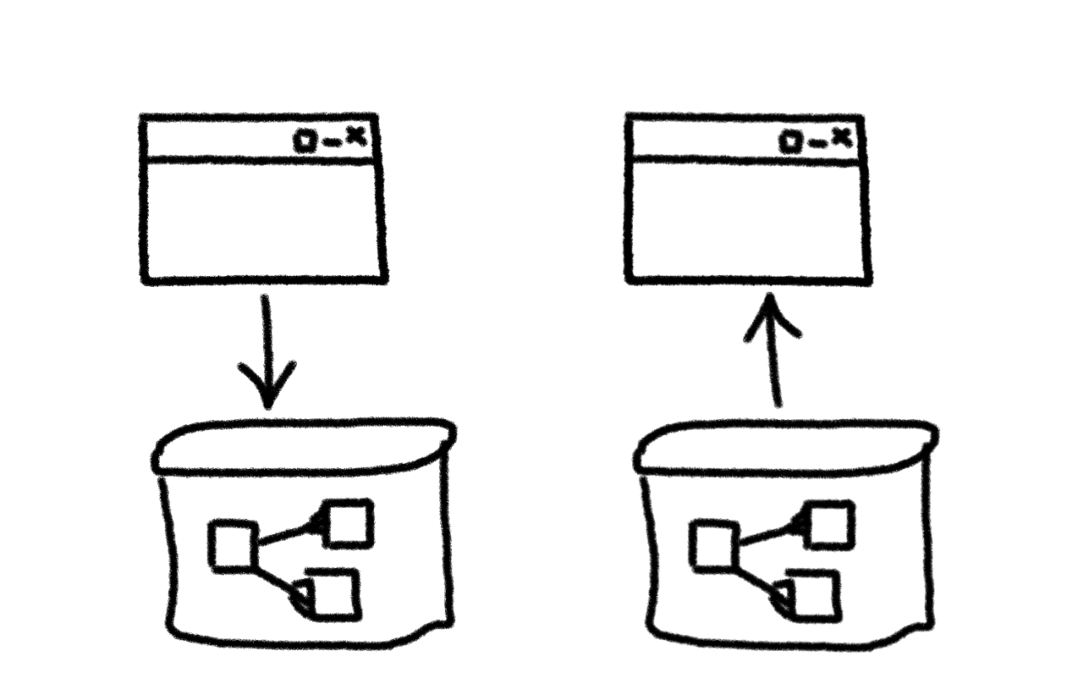
Design Strategy
Up to Down Down to Up

Slide 5
Up to Down
Prototyping
Small projects
POCs

Slide 6
Down to up
- More than 10 entities
- More than 10.000 rows
- Enterprise data stores

Slide 7
Architecture layers isolation
Business logic
Doesn't know about
Knows about
ORM
Knows about
Doesn't know about
Database

Slide 8
Database layer design steps ( 3x3 rules )
1) Define business entities
2) Define logical relations between entities (logical model)
3) Create physical model ( use 3 log-phis rules )
  1 to 1
  1 to N
  M to N

Slide 9
One to One relationships
Entity A
Entity B
1
1
A KEY
B KEY
(A FIELDS)
(B FIELDS)
Table A
A KEY (PK)
(A FIELDS)
(B FIELDS)

Slide 10
One to Many relationships
Entity A
Entity B
1
1
N
A KEY
B KEY
(A FIELDS)
(B FIELDS)
Table A
Table B
A KEY (PK)
B KEY (PK)
(A FIELDS)
A KEY (FK)
(B FIELDS)

Slide 11
Many to Many relationships
Entity A
Entity B
M
N
A KEY
B KEY
(A FIELDS)
(B FIELDS)
Table A
Table A_B
Table B
A KEY (PK)
A KEY (PK)(FK1)
B KEY
(A FIELDS)
B KEY (PK)(FK2)
(B FIELDS)

Slide 12
Self related entities
Entity A
Entity A
A KEY
N
A KEY
N
(A FIELDS)
(A FIELDS)
1
M
Table A
Table A
Table A_RELATION
A KEY 1 (PK)
A KEY 1 (PK)
A KEY 1 (PK)(FK1)
A KEY 2 (FK)
(A FIELDS)
A KEY 2 (PK)(FK2)
(A FIELDS)

Slide 13
3 -rd normal form
1 NF : Atomicity. Only one value in one cell.
2 NF : Non key attributes depend on key
3 NF : Non key attributes depend on key without transitive dependency

Slide 14
Design check list
- Tables are in 3-rd NF (in most cases)
- All the tables have primary keys
- All the related tables refer each other with foreign keys
- Tables should have indexes at least on PK and FK (in most cases)

Slide 15
Don't map a field if you don't need it
Extra field requires the extra work:
- Mapping and support unused fields
- Extra CPU and memory usage
- Extra network load

Slide 16
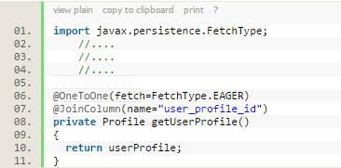
Use lazy loading
Use EAGER fetch type in cases External object is ALWAYS used with the subsequent object
Take care of CASCADE loads

Slide 17
Create queries that return as litle information as possible
Save network
Save memory
Save CPU

Slide 18
Do refactoring as soon as possible
Technical debt is like a credit. You pay anyway but always with %
Design problems take additional time:
  For development
  For bug fixing
  For implementing of workarounds
  Locks and Deadlocks
  etc.

Slide 19
Consider using views
Frequent, complex but similar queries
Group of tables used primarily for requests together
Materialized views

Slide 20
Profile requests
Database Profilers
ORM debug outputs
  <!--hibernate.cfg.xml -->
  <property name="show_sql">true</property>
  <property name="format_sql">true</property>

Slide 21
Use appropriate data types
- Use as short data length as possible
- Do not use variable data length if the length is constant (Ex: Passport series)
- Sometimes XML is a good decision as column data type.

Slide 22
Create performance testing at the very begining
How fast you save data?
How fast you read data?
How app perform when data size is comparable to production data size?
How app perform when many users perform reads and writes?
How often data locks occur?

Slide 23
Conclusion
Pay attention to design and architecture layers responsibility
Learn more about Database Design
Measure your performance and create load tests
Refactor as soon as possible
Keep in mind when it’s appropriate to use down-to-up and up-to-down strategies

